Slide 1
Project Youth
PLUSHIES
MAKING

Slide 2
TABLE OF CONTENTS
01
02
03
Kangaroo
Beaver
Bears
01
02
03
slide 3
Slide 17
Slide 27

Slide 3
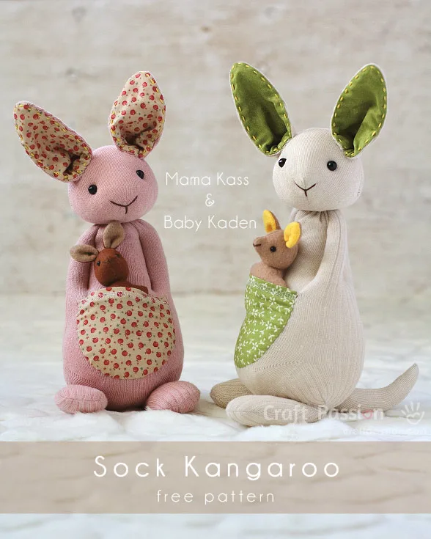
Kangaroo!
https://www.craftpassion.com/sock-kangaroo-sewing-pattern/

Slide 4
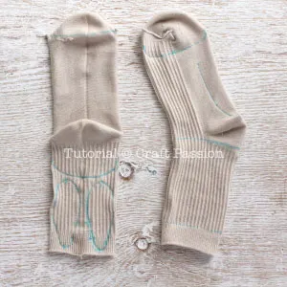
Kangaroo- Draw & Sketch:
Turn the socks inside out, align the socks as shown in the picture. Pin.
Sketch and trace the pattern templates on the socks.
The left sock is the one with the elastic strings taken out.

Slide 5
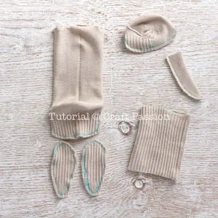
Kangaroo- Sew Then Cut:
Sew and cut out the pieces according to the dashed red lines and blue lines respectively as stated in the pattern template.

Slide 6
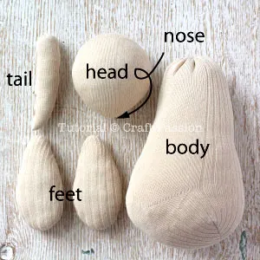
Kangaroo- Stuff:
Turn the pieces right-side-out and stuff firmly with poly-fill stuffing material, sew to close the openings.
Shape the head of the kangaroo stuffed animal so that the nose is pointy while the back is round. Stuff the bottom half body densely and shape it round at the bottom and slender at the top, just like a pear.
The feet should be flat and wide.
The tail is arched at the tip.
Set aside while you work on the ears. You may spray some water on the pieces to erase the marking while waiting, otherwise, you can do it at the end of the project.

Slide 7
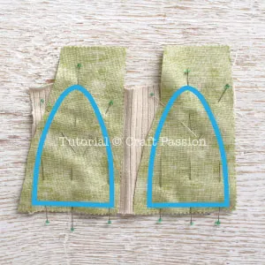
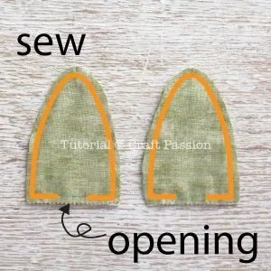

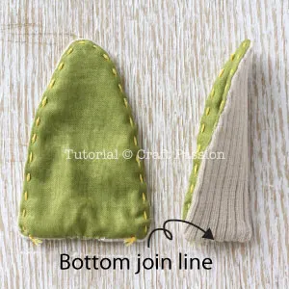
Kangaroo- Sew ears:
Cut and open flat the sock piece that was reserved for the ears. Trace the ear pattern on the wrong side of the fabric piece then place it on the sock piece with the right side facing each other, pin.
Stitch around the sewing lines and leave an opening at the bottom for turning the ear right-side out.
Turn the earpieces right-side out, sew to close the opening.
Sew running stitches near the edge of the ear with yellow embroidery floss. Do not pierce the needle through the sock material, just stitch on the fabric and the seam allowance inside the ear.
Fold the ear and sew the bottom together.

Slide 8
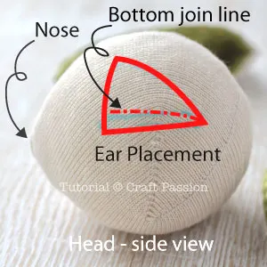
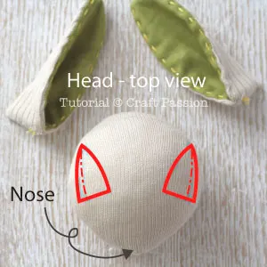
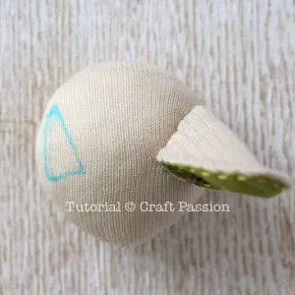
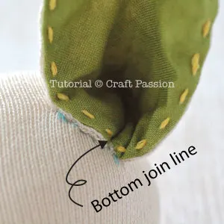
Kangaroo- Sew ears 2.0:
Draw a horizontal line at the end of the “toe seam line” of the sock that appears on the headpiece. This is the position of the bottom seam line of the ear.
The triangle is the sewing line of the ear to the head.
The top view and ear placement. Make sure their positions are the mirror of each other.
Align the bottom join line of the ear to the drawn line, pin the earpiece to the head and sew around to attach the ear to the head.
Top view of the head after one ear is sewn.

Slide 9
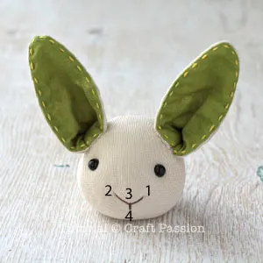
Kangaroo- Sew eyes and mouth:
Sew the button eye to the head, the position is about 1/2″ to 3/4″ below the ear. Pinch the positions with your fingers to check if they are your desired place to put eyes. Mark them down.
Sew one eye and pull the sewing thread down to the bottom of the head, pull to make the eye sink into the head. Make a few more stitches to fasten it securely.
Repeat the same to attach the other eye.
Sew the nose with brown embroidery floss; begin at the bottom of the head, out at 1, in at 2, out at 3, and in at 4, end the sewing at the bottom of the head. Set aside.

Slide 10
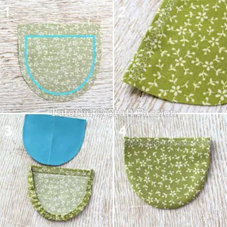
Kangaroo- Sew pouch (use the felt instead of fabric)
1. Cut the pouch piece, with 3/4″ seam allowance on the top and 1/4″ on the rest.
2. Double fold the top edge and topstitch with decorative stitches.
3 & 4. Use a running stitch to gather the curved edge of the pouch, place the template on it, align the top edge, and pull to tighten the thread to pull the seam allowance inward. Iron to set the crease line.

Slide 11
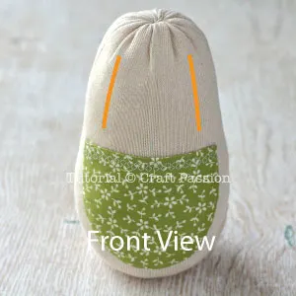
Kangaroo- Sew pouch (use the felt instead of fabric)
Place the pouch on the bottom half of the body, pin and sew the pouch to the body, leaving the top edge of the pouch open.

Slide 12
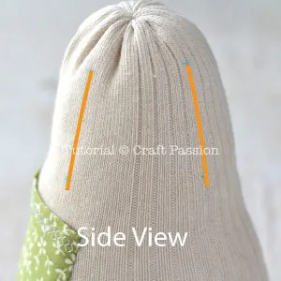
Kangaroo- Sew arms 1.0
The arms are made by sewing indent lines on the body.
Mark a 1.5″ long on both sides of the body, as shown in the above picture. This is the arm position of the sock kangaroo.
Mark similar lines at the back of the sock kangaroo. This is the side view of the body that shows 2 lines that will make the arm.

Slide 13
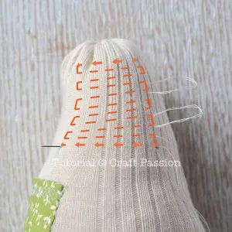
Kangaroo- Sew arms 2.0
Sew stitches across the 2 lines, as shown in the picture. Leave longer thread (loop) in between the stitches so that you can pull the thread to tighten the stitches hence form the arm.

Slide 14
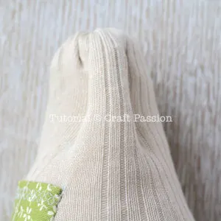
Kangaroo- Sew arms 2.0
Gently pull the thread via the loop to tighten the stitches and form the arm, as shown in the picture.
Similarly, stitch across the arm in an upward direction to give it more secure sewing.
Repeat the same for the other arm

Slide 15
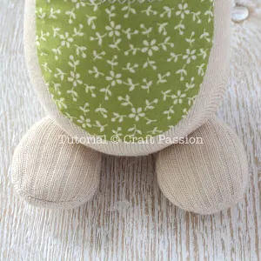
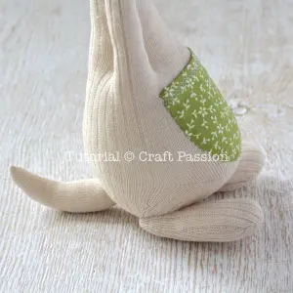
Kangaroo- Sew body parts
1. Sew Feet: Place the feet below the body with wider width facing the front, pin, and sew around the points that the foot touches the body.
2. Sew Tail:
Sew the tail to the center bottom of the body. The tail is the “support” that makes the sock kangaroo stuffed animal stand on its own without tumbling down from behind.

Slide 16
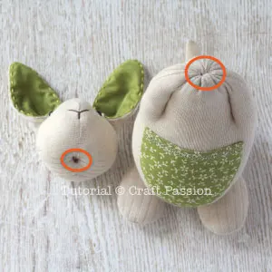
Kangaroo- Sew pouch (use the felt instead of fabric)
Sew Head To Body:
Mark 2 small circles on the bottom of the head and top of the body, this is where they are going to be joined up.
Place the head on the bode, align the center lines, pin, and sew around securely to complete the sock kangaroo.

Slide 17
You are done!

Slide 18
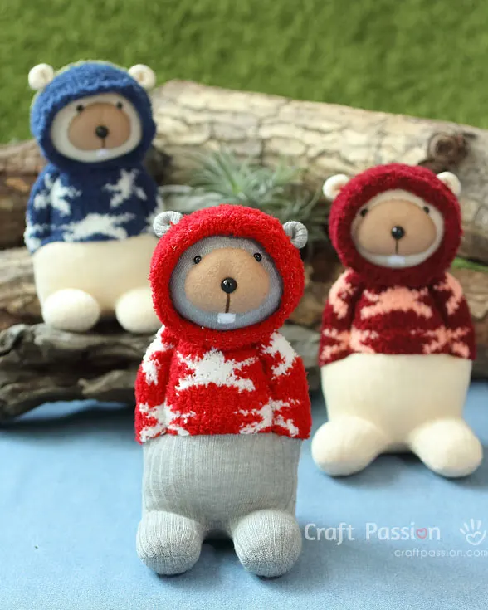
Beaver!
https://www.craftpassion.com/how-to-sew-sock-beaver/

Slide 19
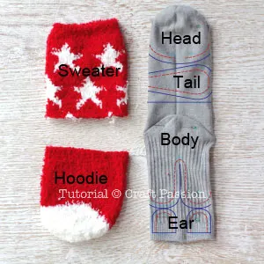
Print out the templates and cut them out
Follow the Sock Beaver pattern template to trace the pieces on the socks. You might need to adjust the size of the templates a little so that they fit into your socks.

Slide 20
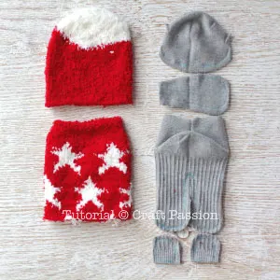
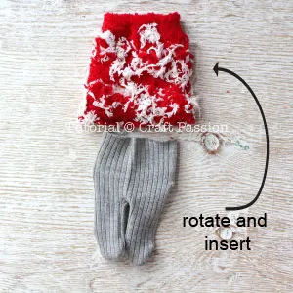
Cut the pieces out from the socks
Turn all pieces right-side out. Turn the “sweater” piece to right-side in.
Rotate the sweater and insert the body into the sweater, align the raw edges just like the next picture.

Slide 21
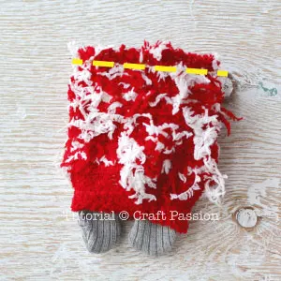
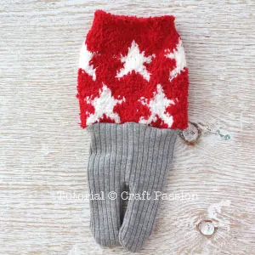
Sew the yellow line
Pin and sew around the yellow dashed line.
Turn the sweater right-side out. This is the body of the sock beaver wearing a sweater.

Slide 22
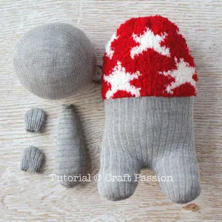
Stuff all parts with stuffing materials
Stuff the head very firm, shape it round.
Stuff the feet firmly and shape it round. Stuff the bottom of the body firmly and shape it round.
Try to limit the stuffing at the groin line, ie. between the feet and bottom body, so that the sock beaver can sit firmly.
Stuff the upper body loosely, shape it slender towards the top.
Stuff and shape the tail flat.
Sew to close all openings.

Slide 23
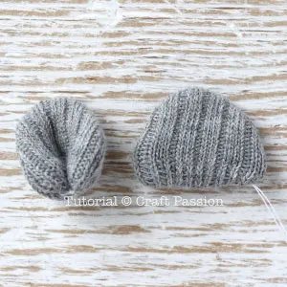
Ears
Fold the raw edges into the ear, sew to close the opening. Fold the corners together and sew the bottom.
Repeat the same to the other ear.

Slide 24
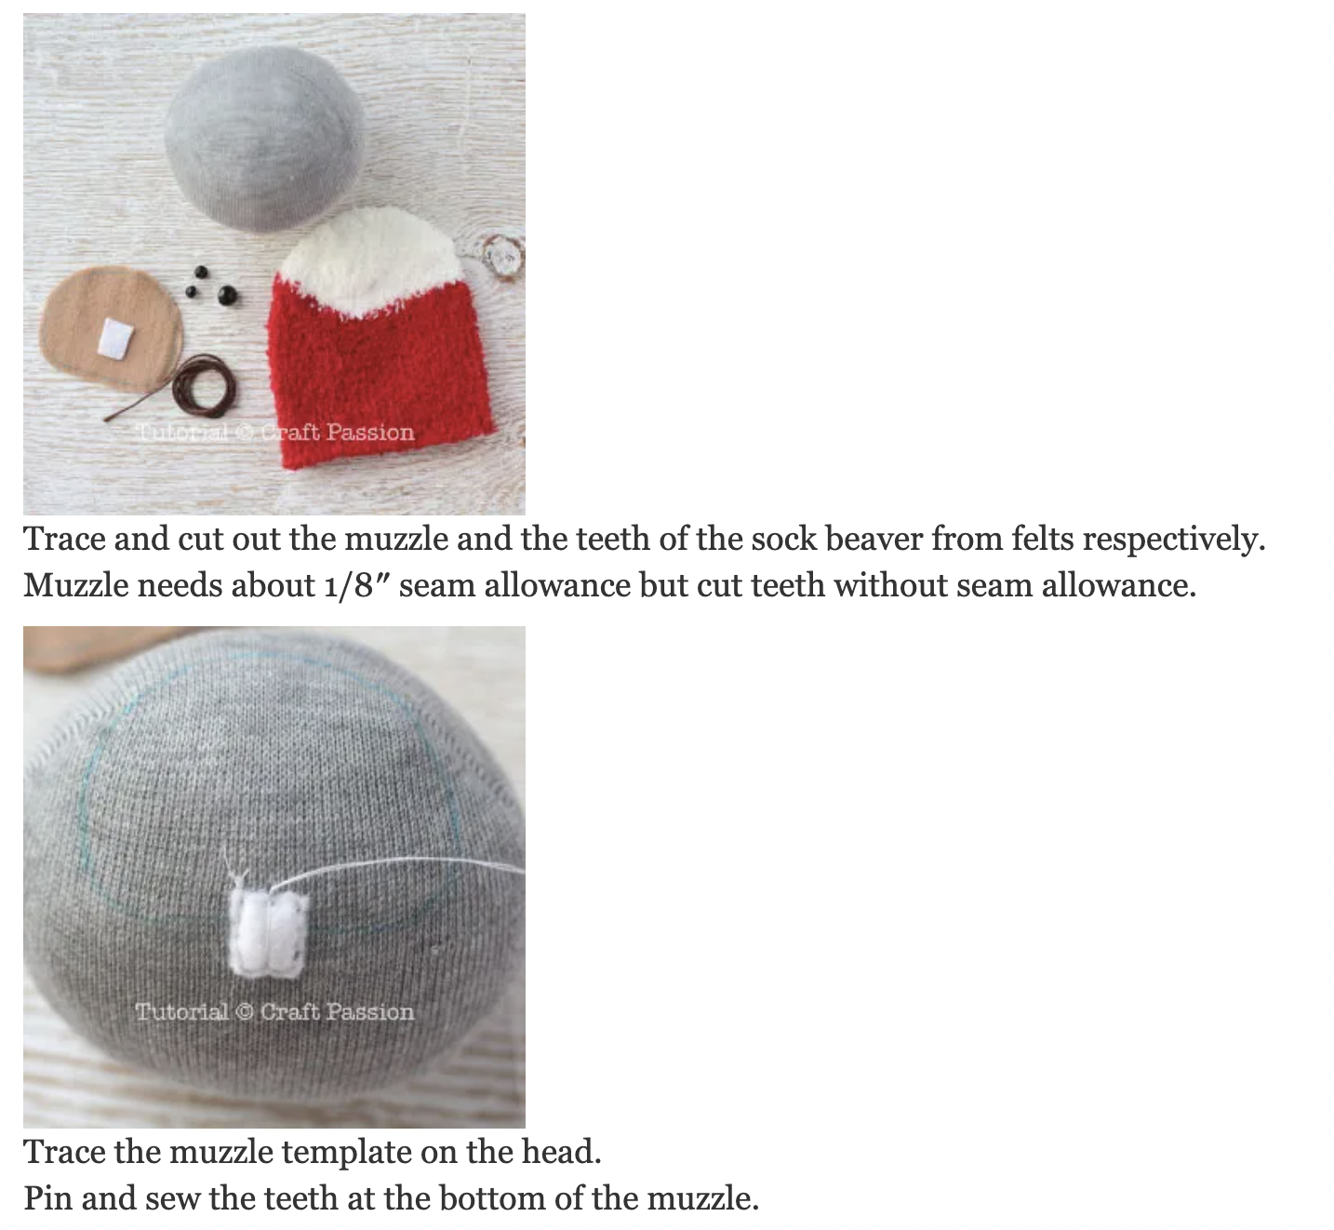
Muzzle 1.0
Trace and cut out the muzzle and the teeth of the sock beaver from felts respectively. Muzzle needs about 1/8″ seam allowance but cut teeth without seam allowance.
Trace the muzzle template on the head.
Pin and sew the teeth at the bottom of the muzzle.

Slide 25
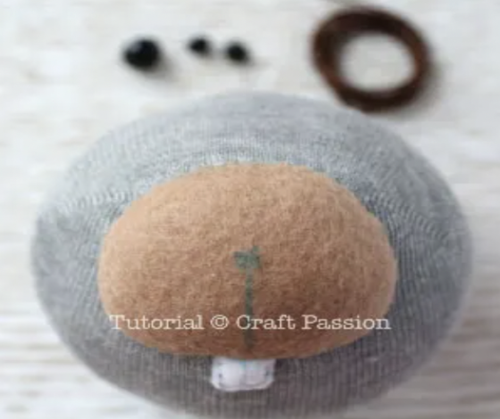
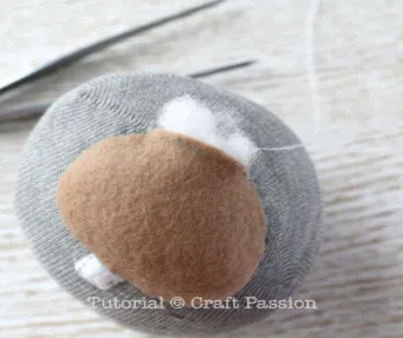
Muzzle 2.0
Pin the muzzle on the head, turn the raw edge in and sew around to attach the muzzle.
Pause sewing and stuff the muzzle firmly when you are about an inch away to finish the sewing.
Continue to sew to close up the opening of the muzzle.
Mark the philtrum line at the center of the muzzle and draw a vertical line down to the center of the teeth.

Slide 26
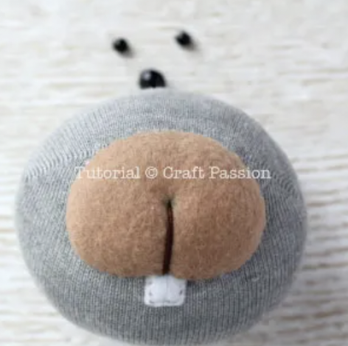
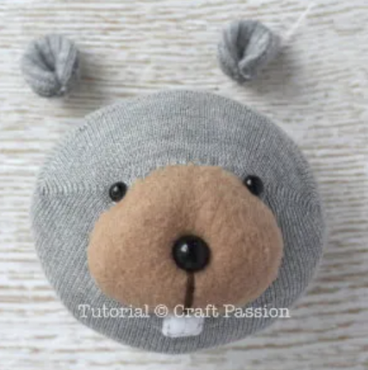
Face
With 6 strands of embroidery floss and tapestry needle, knot the floss at the bottom center of the head securely, insert the needle and come out from the bottom of the muzzle. Insert the needle into the head again from the center marking of the muzzle. Pull to make a dented line that resembles the philtrum. Repeat again if necessary to add another secure stitch. End the sewing with a knot at the bottom of the head.
Sew to attach the eyes and nose to the beaver head. Pull the thread tight enough to sunken the buttons. Again, all sewings should begin and end at the bottom of the head.
Notes:
https://www.craftpassion.com/how-to-sew-sock-beaver/

Slide 27
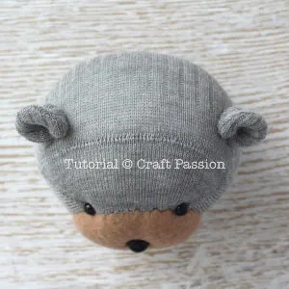
ears
Project a straight line from nose to eyes and extend it to the top of the head, this is the ear position. Pin and sew around the bottom of the ear to the head. Repeat the same to attach the other ear.
Finished with the head!

Slide 28
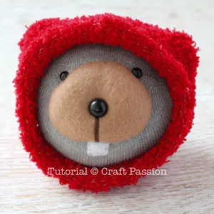
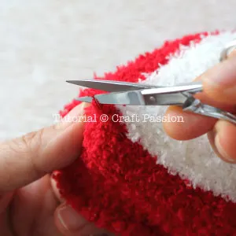
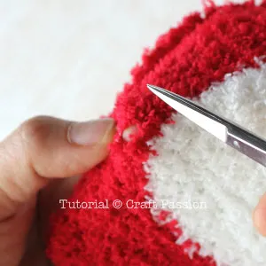
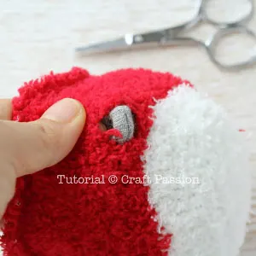
Hood
Cover the head with the hood cut out from the microfiber chenille sock.
Mark the ear position on the hood.
Stretch out the knit on the marking and cut the closest strand of yarn to the marking. This is to create a hole on the hood for the ear.
Check to see if the hole is big enough, you may use your finger to stretch the hole to make it bigger. If the hole is not big enough for the ear to pass through, snip another strand of yarn next to the first one you have snipped.
Wear the hood over the ear.
If you’ve accidentally cut the hole either too big or cut at a wrong position, just mend it up with matching color thread. The chenille yarn will cover up the mistake you have made.

Slide 29
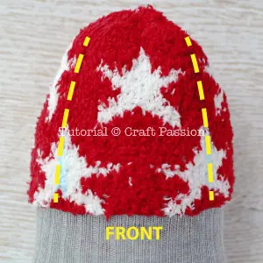
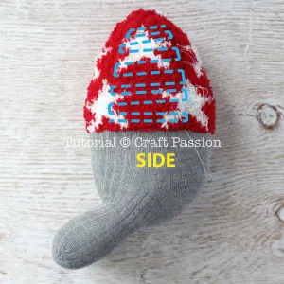
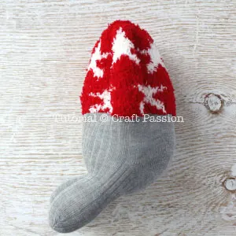
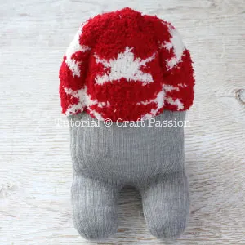
body
Apportion the body into 4 equal widths, mark the arms of the beaver as shown in the picture. Mark the back as well.
Sew ladder stitches between these 2 lines, don’t pull the thread yet. Besides making loose sewing, leave a longer thread in between stitches along the loop.
Pull the thread gently but firmly from the long thread loop, the sock will bump up and the “arm” of the sock beaver will form.
Knot the thread.
Repeat the same to the other arm. Front view of the sock beaver.

Slide 30
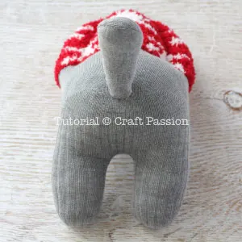
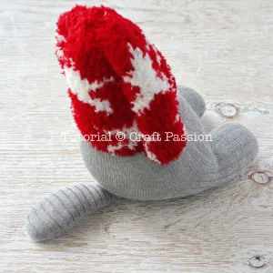
tail
Sew the tail to the sock beaver.
The tail is the “support” that makes the sock beaver to stand on its own without tumbling down from behind.

Slide 31
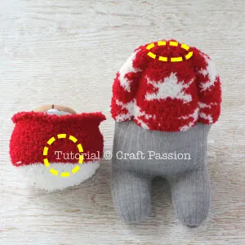
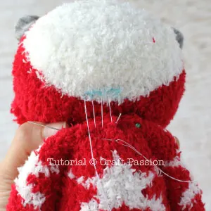
Place the head to the body, find the best position to your liking, be it looking straight, looking up, looking down or even looking sideways, mark the circles on the head and body respectively.
Pin and sew the attach the head to the body.

Slide 32
You are done!

Slide 33
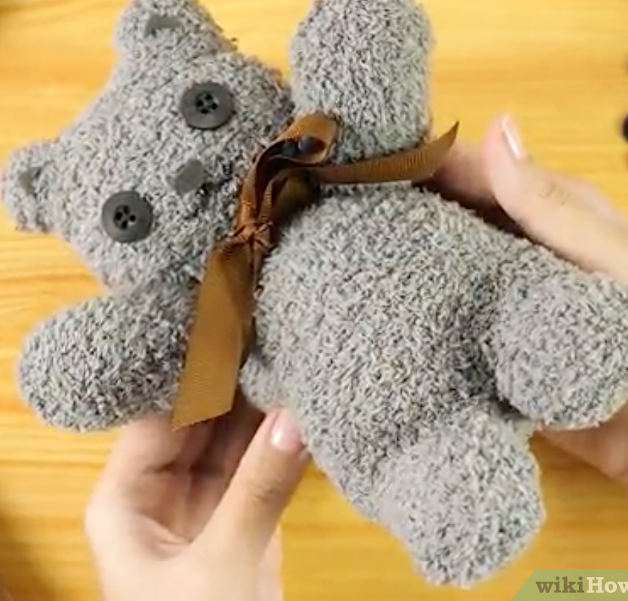
BEAR- SOCKS
https://www.wikihow.com/Make-a-Teddy-Bear
Notes:
https://www.wikihow.com/Make-a-Teddy-Bear

Slide 34
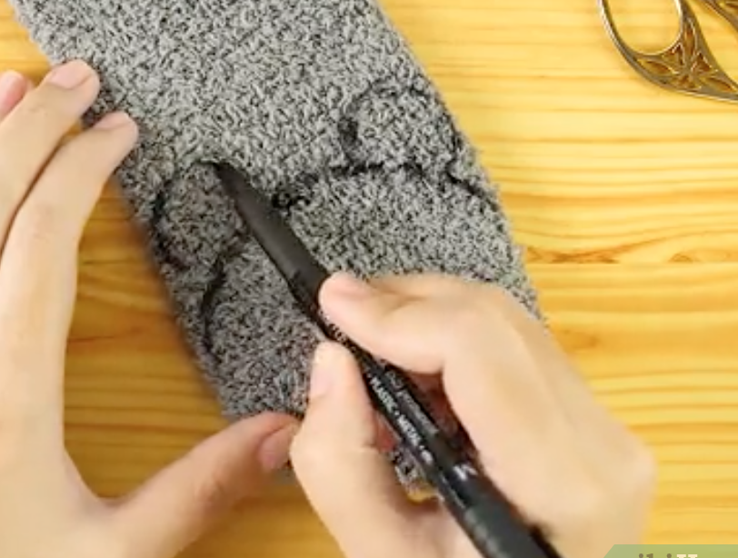
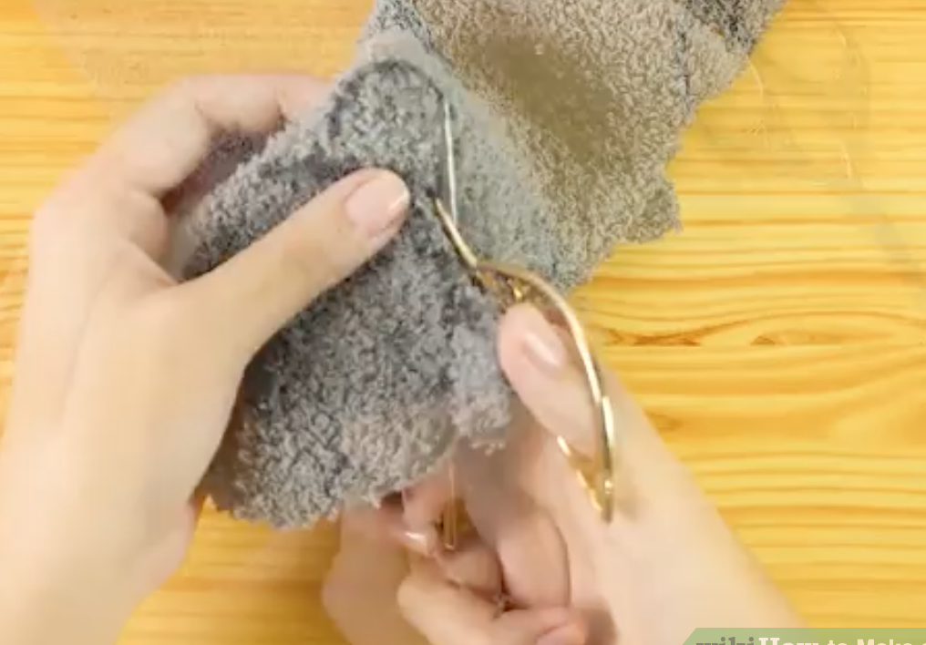
Lay out and cut ‘head’
Draw the outline of the bear’s head
Cut the fabric just above the line of the ears. Then cut off just a sliver of fabric at the very base of the circle to make a hole for the neck.

Slide 35
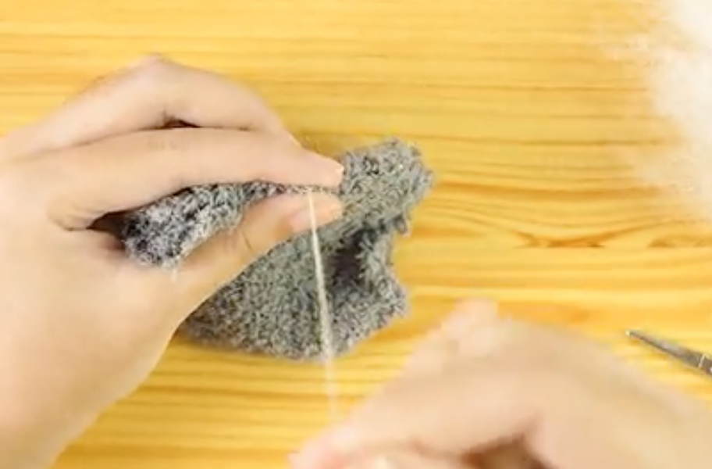

Stuff and sew the head
Flip the head inside out and then use sew the top of the head closed.
Once it's closed, flip it right side out and then stuff the head with filling. Sew the neck closed when you've reached the desired head size.

Slide 36

Cut out the fabric for the arms and legs

Slide 37

Stuff and sew the body
Flip the body inside out and then use a sewing machine or your hands to sew the legs closed. Once they're closed, flip it right side out and then stuff the body with filling. Sew the neck closed when you've reached the desired body size.

Slide 38

Attach the body to the head
Sew the head onto the body by hand using a basic running stitch or a saddle stitch.

Slide 39


Sew on the arms
Cut the end piece into two pieces to create the arms. Sew them partially closed and then stuff them. Attach them to the body once you are happy with how they look. You can add any features that you like.

Slide 40
You are done!

Slide 41

BEAR- BLANKET/FELT
https://www.wikihow.com/Make-a-Teddy-Bear
Notes:
https://www.wikihow.com/Make-a-Teddy-Bear

Slide 42

Make the arms
Cut out four arms by using the template. Sew two pieces together to form each one of the arms. Leave a slit at the end open for stuffing.

Slide 43

Make the legs
Cut out 4 legs by using the template. Sew two pieces together to form each one of the legs. Leave a slit at the end open for stuffing.

Slide 44

Cut the head
Cut out two pieces by using the template. Stitch them together from the neck up to the nose.

Slide 45


Cut the head gusset
Cut the gusset, or middle piece, to go between the two head pieces you already cut and sewed. You will need to line it up at the neck and pin it in place before sewing.
Once you've drawn and cut out the shape, sew the gusset into place between the existing head pieces.

Slide 46

Make the body piece
Cut the two pieces of body by the templates. Sew the sides together, along the long edges, so that you end up with a sort of tube.

Slide 47

Turn all the pieces inside out
Using a pencil can help. Turning the pieces hides the seams you made.

Slide 48


Stuff and attach the head
Pre-stuff the head and sew it to the top of the body piece, at the open, short end.

Slide 49


Attach the arms and legs
Now sew both the legs and the arms (leave the last leg off), stuff the bear with filling and then sew the last leg

Slide 50

Cut and attach the ears
Cut 4 ears out by the template, and sew them on to the head.

Slide 51

Add some features
Give your bear a face!!!! And YOU ARE DONE!!!!

Slide 52
You are done!

